Slide 1

Chapter : 03
Course Title: Assembly Language Lab
Course Code : CSE231L
Thanjida Akhter

Slide 2
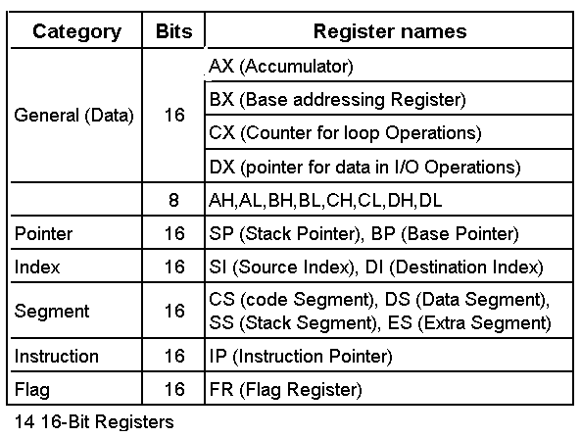
Registers of the 8086/80286
Thanjida Akhter

Slide 3
General Purpose Registers
AX
AH AL
7 0 7 0
BX
CX
AX
0
DX
Thanjida Akhter

Slide 4
General Purpose Registers
AX (Accumulator) – arithmetic, logic and data instructions.
BX (Base) – can hold the address of a procedure or variable (SI, DI, and BP can also). Can also perform arithmetic and data movement.
CX(Count) – acts as a counter for repeating or looping instructions.
DX(Data) – holds the high 16 bits of the product in multiply (also handles divide operations), also I/O operation.
Thanjida Akhter

Slide 5
Segment Registers
CS
SS
CS
0
DS
ES
Thanjida Akhter

Slide 6
Segment Registers
  Used as base locations for program instructions, data and the stack
CS(Code Segment) – holds base location for all executable instructions in a program
SS(Stack Segment) - Base location of the stack
DS(Data Segment) – default base location for variables
ES (Extra Segment )– additional base location for memory variables.
Thanjida Akhter

Slide 7
Pointer and Index Registers
BP
SP
BP
0
SI
DI
Thanjida Akhter

Slide 8
Pointer Registers
BP (Base Pointer) – contains an assumed offset from the SS register. Often used by a subroutine to locate variables that were passed on the stack by a calling program.
SP(Stack Pointer )– Contains the offset of the top of the stack.
Thanjida Akhter

Slide 9
Index Registers
SI (Source Index)– Used in string movement instructions. The source string is pointed to by the SI register.
DI( Destination Index) – acts as the destination for string movement instructions
Thanjida Akhter

Slide 10
IP and Flags
IP
0
IP
Flags
Status Flags
Control Flags
Thanjida Akhter

Slide 11
IP and Flags
IP(Instruction Pointer) – contains the offset of the next instruction to be executed.
Flags Register – individual bit positions within register show status of CPU or results of arithmetic operations.
  Control Flags (Direction, Interrupt, Trap)
  Status Flags (Carry, Overflow, Sign, Zero, Auxiliary Carry, Parity)
Thanjida Akhter

Slide 12
Status Flags
Carry (CF) – set when the result of an unsigned arithmetic operation is too large to fit into the destination.
Overflow(OF) – set when the result of a signed arithmetic operation is too wide to fit into the destination.
Sign(SF) – set when the result of an arithmetic or logical operation generates a negative result.
Thanjida Akhter

Slide 13
Status Flags
4. Zero(ZF) – set when the result of an arithmetic or logical operation is zero.
5. Auxiliary Carry(AF) – set when the result of an operation causes a carry from bit 3 to bit 4.
6. Parity(PF) – reflects whether the number of 1 bits in the result of an operation is even or odd. 1 – odd, 0-even.
Thanjida Akhter

Slide 14
Control Flags
Interrupt(IF) – dictates whether or not system interrupts can occur. 1 – enabled, 0 – disabled.
Trap(TF) – determines whether or not the CPU is halted after each instruction. Allows programmers to do tracing.
Direction(DF) – affects block data transfer instructions such as MOVS, CMPS. 0 – up, 1 – down.
Thanjida Akhter

